Slide 1
Secondary Storage
7
Chapter 7

Slide 2
Learning Objectives
Distinguish between primary and secondary storage.
Identify the important characteristics of secondary storage, including media, capacity, storage devices, and access speed.
Describe hard-disk platters, tracks, sectors, cylinders, and head crashes.
Compare internal and external hard drives.
Compare performance enhancements including disk caching, RAID, file compression, and file decompression.
Define optical storage including compact discs, digital versatile discs, and Blu-ray discs.
Define solid-state storage, including solid-state drives, flash memory cards, and USB drives.
Define cloud storage and cloud storage services.
Describe mass storage, mass storage devices, enterprise storage systems, and storage area networks.

Slide 3

Introduction
Data storage has expanded from text and numeric files to include digital music files, photographic files, video files, and much more.
These new types of files require secondary storage devices with much greater capacity.
In this chapter, you learn about the many types of secondary storage devices including their capabilities and limitations.

Slide 4
Storage
Primary storage is:
Volatile storage
Loses content when the computer loses power
Temporary storage
Random Access Memory (RAM)
Secondary storage is:
Nonvolatile storage
Stores programs and data regardless of power
Permanent storage
Permanently saves information for future use
Notes:
Primary storage (key term) temporary storage
Primary storage is temporary – loses content when computer loses power
Secondary storage (key term) permanently saves information for future use; to share information with others; to modify at later date using secondary storage devices (key term)
Secondary storage is nonvolatile – stores programs and data as opposed to temporary storage (RAM)

Slide 5
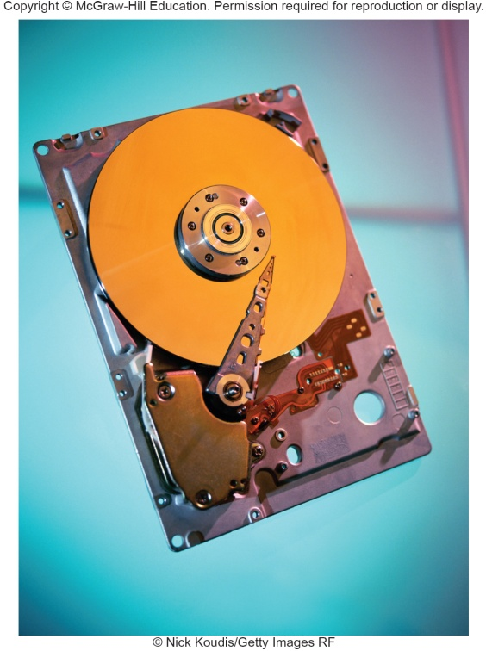
Secondary Storage Characteristics
Secondary storage characteristics
Media
Physical materials that holds data and programs
Capacity
How much the media can hold
Storage devices
Hardware that reads data and programs
Access speed
Amount of time required to retrieve data from storage
Writing is the process of saving information to storage
Reading is the process of accessing information from storage
Notes:
Characteristics include:
Media or medium (key term) – actual physical materials that holds the data and programs
Capacity (key term) – measures how much a particular storage medium can hold
Storage devices (key term) – hardware that reads data and programs from storage media (most also write to storage media)
Access speed (key term) – measures the amount of time required by the storage device to retrieve data and programs
Writing– process of saving information to the secondary storage device
Reading – process of accessing information from secondary storage

Slide 6
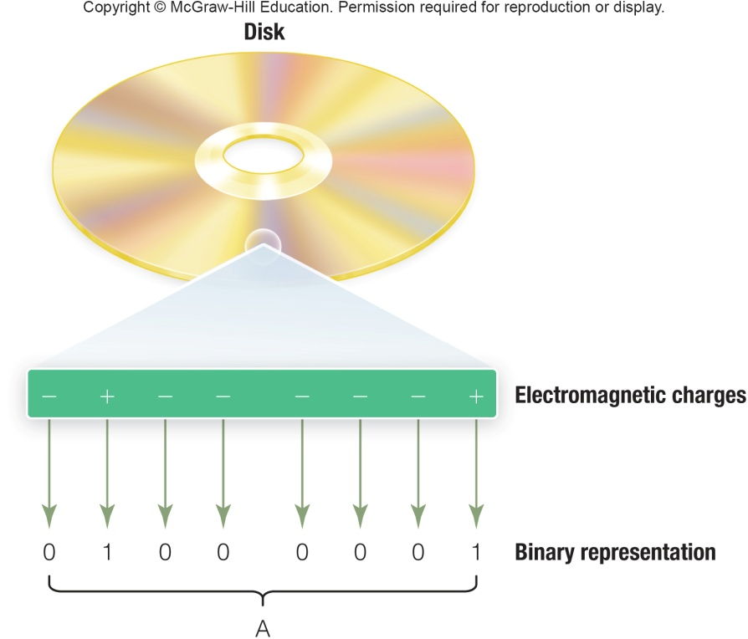
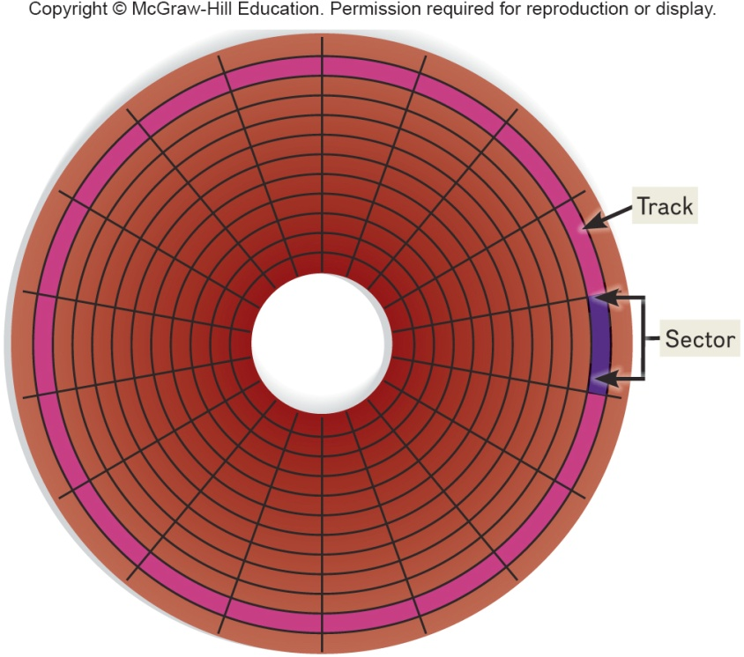
Hard Disks
Save files by altering the magnetic charges of the disk’s surface to represent 1s and 0s
Use rigid, metallic platters that are stacked one on top of one another
Store and organize files using tracks, sectors, and cylinders
How charges on a disk surface store the letter A
Tracks and Sectors
Notes:
Hard disks (key term) save files by altering the magnetic charges of the disk’s surface to represent 1s and 0s. Density (key term) refers to how tightly these charges can be packed next to one another on the disk
Composed of metallic rather than plastic disks
Platters (key term) – rigid metallic, stacked one on top of another
Track (key term) -rings of concentric circles
Each track is divided into wedge-shaped sections called sectors (key term)
A cylinder (Key Term) runs through each track of a stack of platters
When a hard disk is formatted, tracks, sectors, and cylinders are assigned.

Slide 7
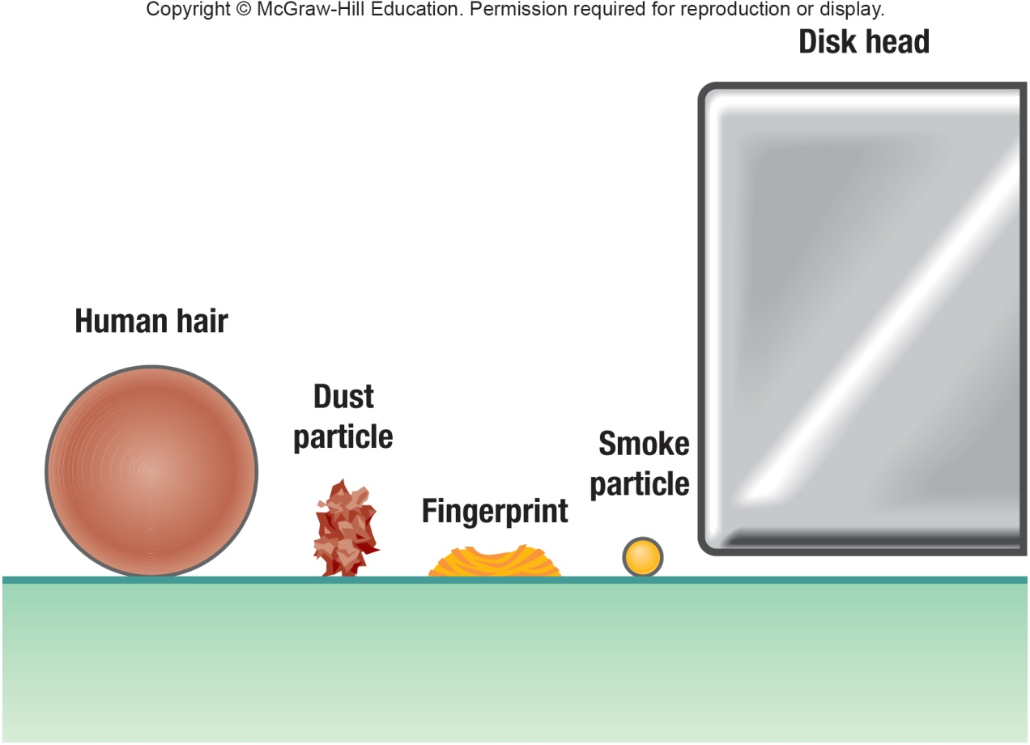
Head Crash
Occurs when read-write head makes contact with the hard disk’s surface or with particles on its surface
Disastrous
Notes:
Read-write head is .000001 inch above surface
Head crash (key term) occurs when read/write head makes contact with surface.
Hard drives are sensitive and something as thin as a human hair can cause a head crash.

Slide 8
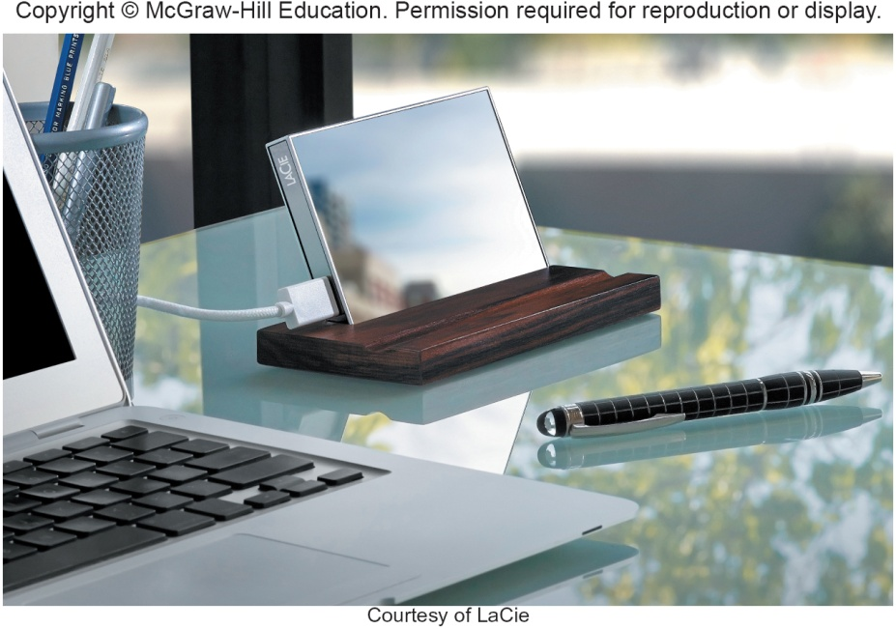
Types of Hard Disks
Internal
Located inside the system unit
Used to store programs and data files
You should perform routine maintenance and periodically backup all important files
External
Removable
Used to complement internal hard disk
Notes:
Internal Hard Disk (key term) - Located inside the system unit
Used for storing the operating system, other programs, and large data files
You should perform routine maintenance and periodically backup all important files
External hard drives (key term) are removable and are used to complement an internal hard disk
Use the same technology as internal hard disk
Used to complement internal hard disk.

Slide 9
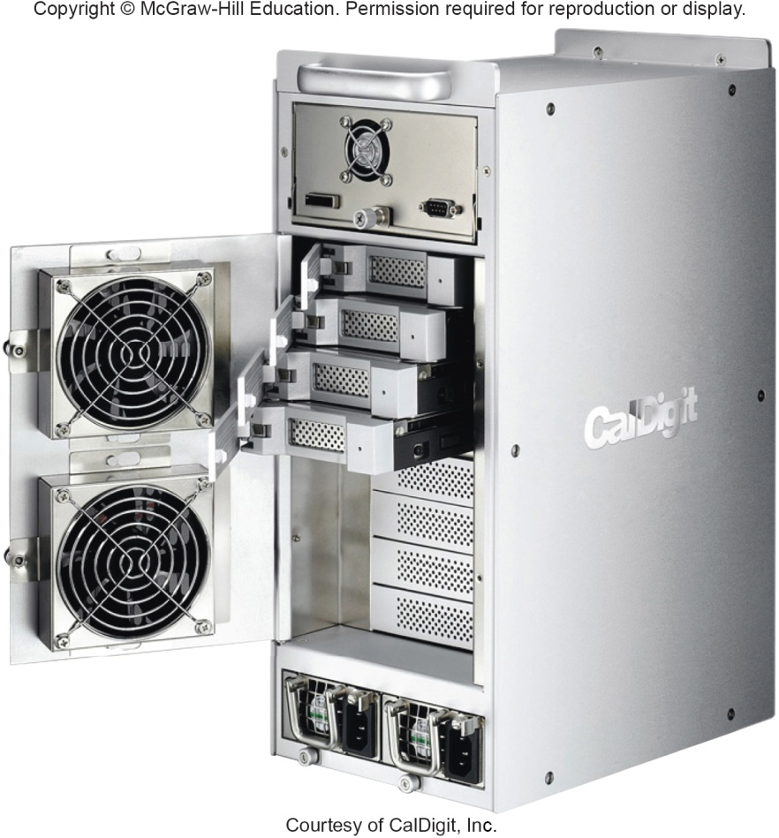
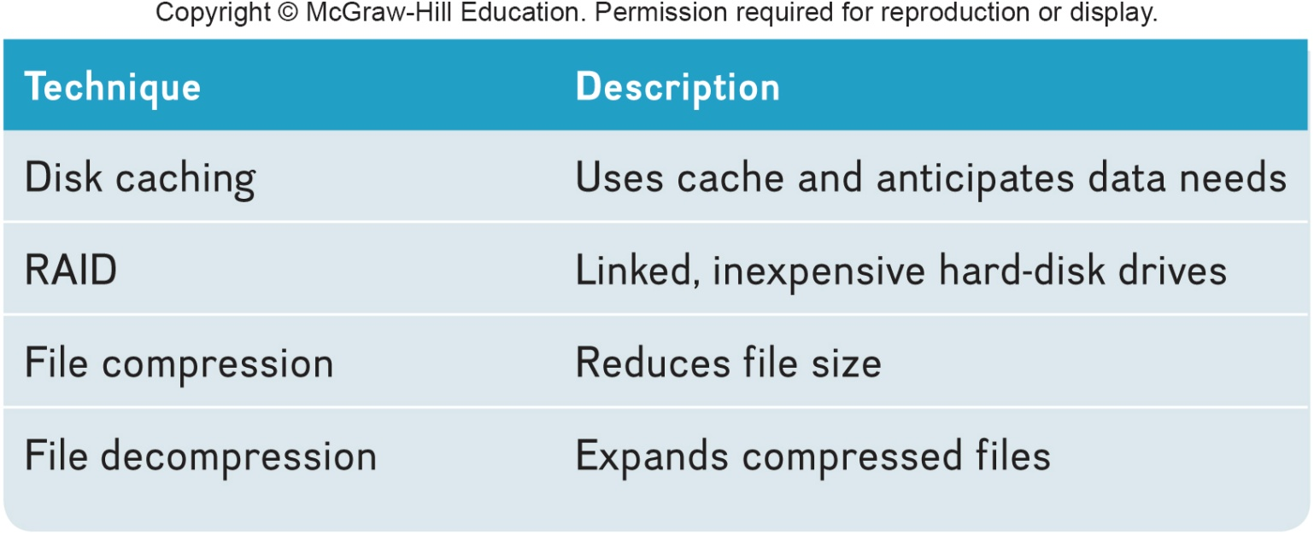
Performance Enhancements
There are 3 ways to enhance performance.
Notes:
Disk caching (key term)
Uses hardware and software to anticipate data needs; performs function similar to RAM caching; improves processing by acting as a temporary high-speed holding area between a secondary storage device (Key Term) and the CPU
Frequently used data is stored in memory; when needed, the access time is much faster
Redundant arrays of inexpensive disks (RAID) (key term)
Groups of low cost hard-disk drives grouped together using networks and special software
Performs as a single large-capacity disk; but faster than a single disk of comparable size
Often used by Internet servers and large organizations
File compression (key term) and decompression (key term)
Increase storage capacity
Increase speed in file transfers
Reduce space required for storage
WinZip is a well-known program, and you can also use utility programs in Windows.
Supported by both Mac and Windows

Slide 10
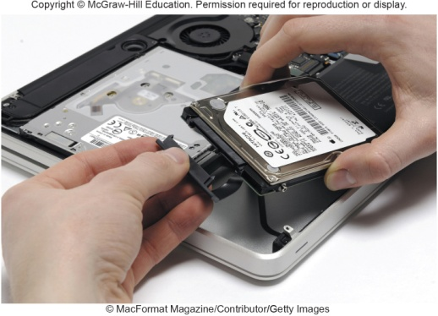
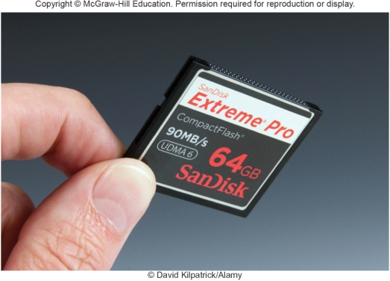
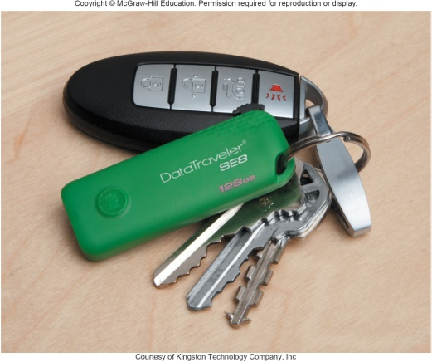
Solid-State Storage
Solid–state devices (SSDs) have no moving parts
Solid-state drives
Faster and more durable than hard disks
Access to slash memory or solid state storage
Flash memory cards
Widely used in laptops, smartphones, GPS navigation systems
USB Drives (or Flash Drives)
Connect to USB port
Capacity of 1 GB to 256 GB
Portable
Notes:
Solid state devices have no moving parts
Solid state drives (key term) are faster and more durable than hard drives
Require less power
Contain solid state memory instead of magnetic disk to store data
Used for tablets, smartphones
More expensive and have a lower capacity than hard drives
Flash memory cards (key term) are one type of solid state device.
Used in digital cameras, ipods
USB Drives (key term) or Flash drives (key term) connect to a USB port
Portable

Slide 11
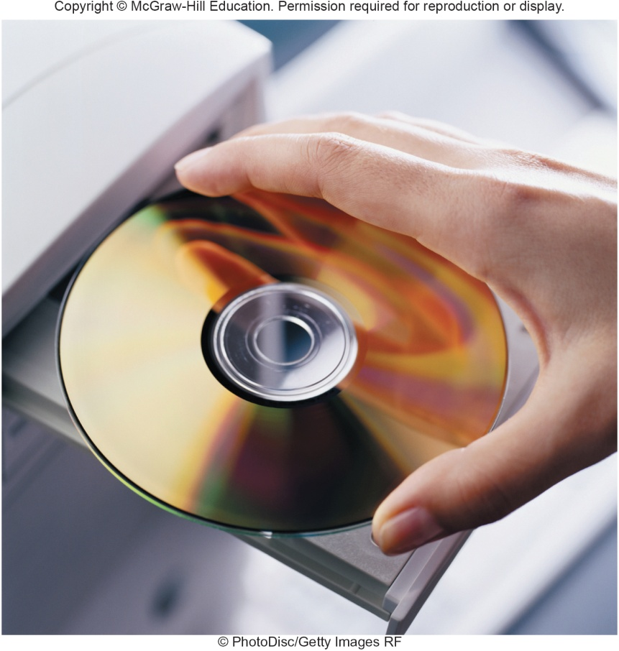
Optical Discs
Hold over 128 gigabytes (GB) of data
Use reflected light to represent data
Lands represent 1s and 0s on the disc
Pits are bumpy areas on the disc that, when light is reflected, determine the 1s and 0s
Use tracks and sectors to organize and store files but only use a single track unlike the hard drive
Notes:
Use laser technology. CD (Key Term) and DVD (Key Term) are optical disc (key term) formats.
Compact, high capacity form of permanent storage (up to 50 gigabytes of data)
Optical discs are read by an optical disc drive (key term)
Laser beam writes by creating a pattern of pits (key term) (holes) and lands (key term) (flat areas) to encode data bits
Laser beams reflect off the pits and lands to read the data
Use tracks and sectors to organize and store files but only use a single track unlike the hard drive

Slide 12
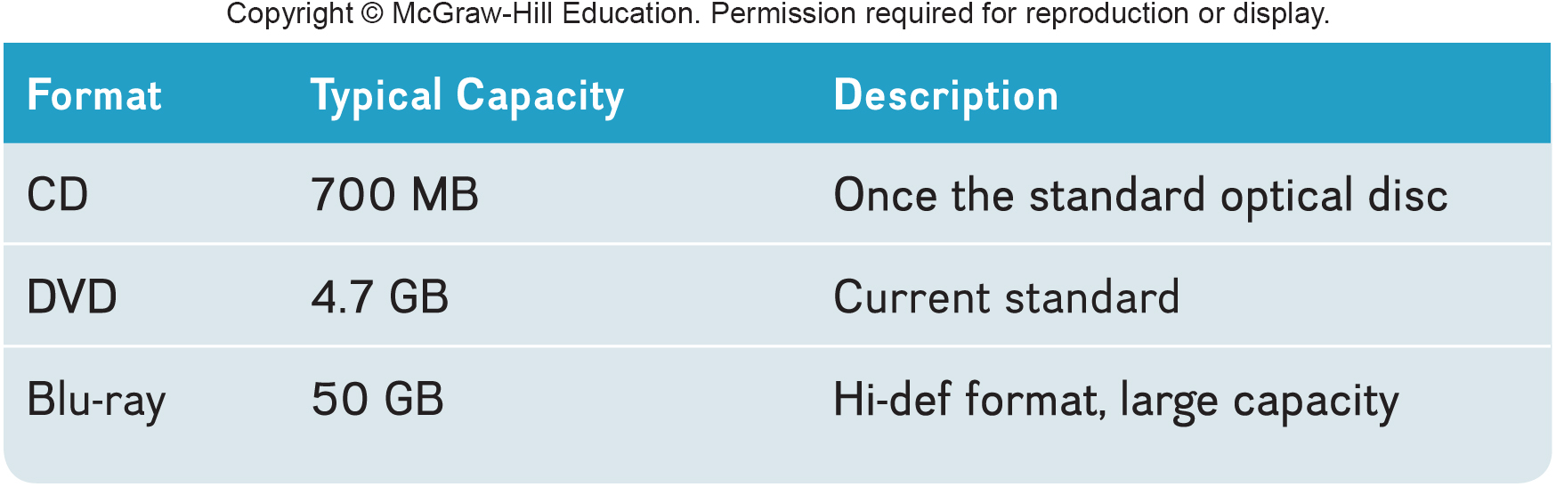
Optical Disc Types
Notes:
Double-sided discs offer twice the storage by using both sides of the disc.

Slide 13
Optical Disc Formats
Type | Access | Description
CD-ROM | Compact disc – read only mode | Cannot be written to or erased
CD-R | Compact disc – recordable | Can be written to
CD-RW | Compact disc – rewritable | Can be written to and erasable
Notes:
Read only: CD-ROM Compact Disc – Read only mode (key term)
Commercial music CD
Read only means it cannot be written on or erased
Used to distribute large databases and references
Write once: CD-R (CD-recordable) (key term)
Used to archive data or to record music downloaded from the Internet
Rewriteable: CD-RW (key term) compact disc rewritable
Known as erasable optical disks (Key Term)
Can be changed
Used to create and edit multimedia presentations

Slide 14
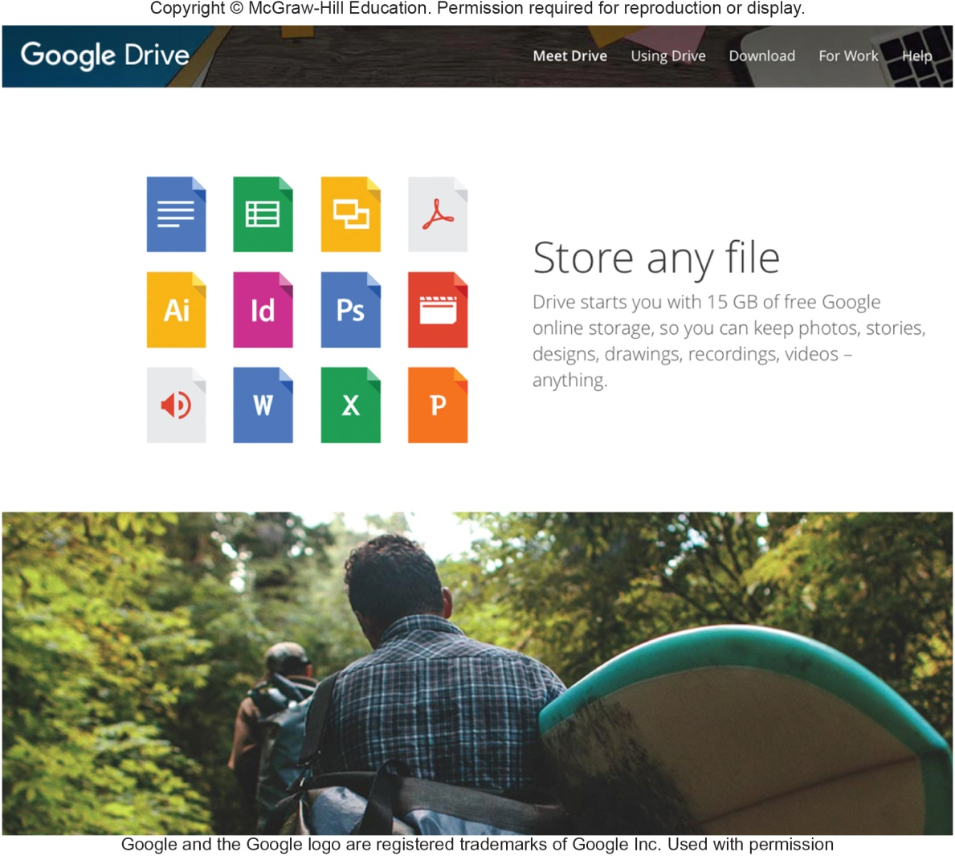
Cloud Storage
The Internet acts as a “cloud” of servers
Applications provided as a service rather than a product
Supplied by servers that provide cloud storage or online storage
Notes:
Cloud computing (key term) is where the Internet provides a cloud of servers that supply applications to clients as a service.
The processing power of the service provider’s server is used to run the applications and your computer is responsible only for displaying the results.
The applications and data can be accessed from any Internet-ready device. This means that devices with little storage, memory, or processing power, such as mobile phones, can run the same powerful applications as a desktop computer.
Cloud servers provide storage, processing, and memory.
Software installation and upgrades are avoided.

Slide 15
Cloud Storage Services
Benefits / Advantages
Maintenance
Hardware upgrades
File sharing and collaboration
Disadvantages
Access speed
File Security
Notes:
Because the service provider’s server is used to run the application and store the files, even devices with little storage, memory or processing power such as a smartphone can run the same applications as a desktop computer.
Benefits that are handled by the cloud service
Maintenance – disk defragmentation, backups, encryption and security
Hardware upgrades
File sharing and collaboration – users can share and collaborate with anywhere with an Internet connection
Disadvantages
Access speed – transfer rate is dependent upon your Internet connection
File Security – may not be as effective as your personal file security

Slide 16
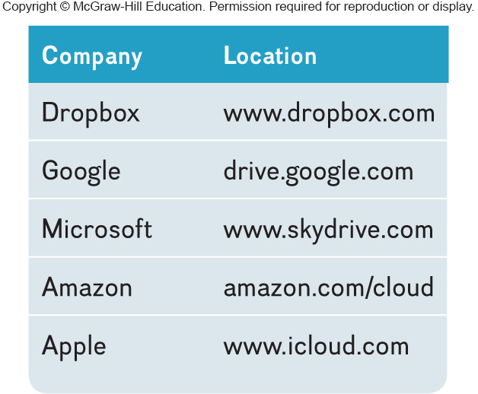
Cloud Storage Service Companies
Notes:
This is a listing of the top 5 cloud storage service companies.

Slide 17
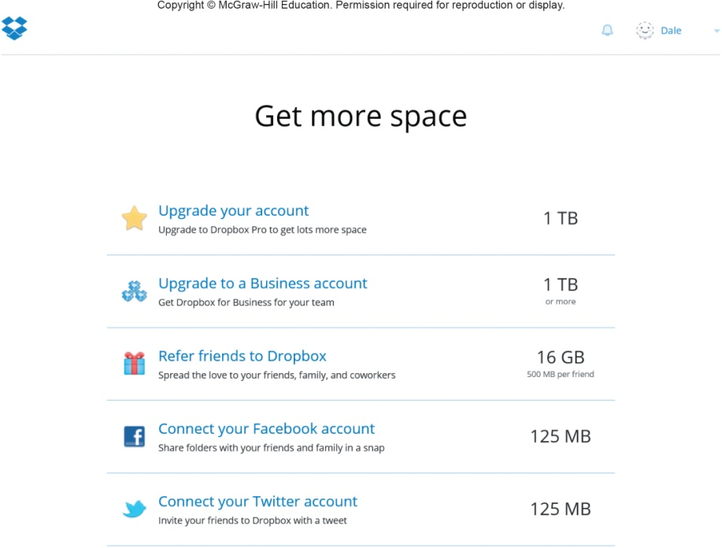
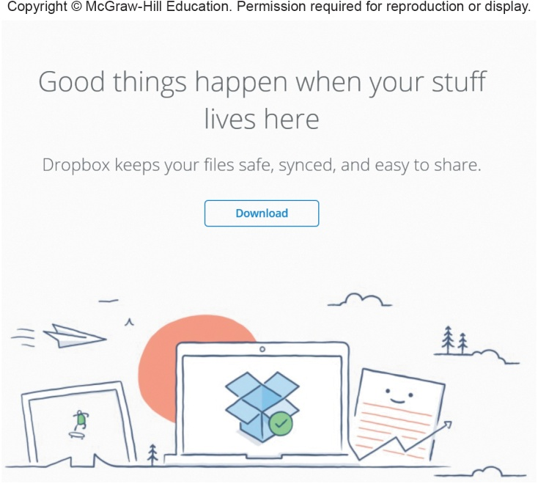
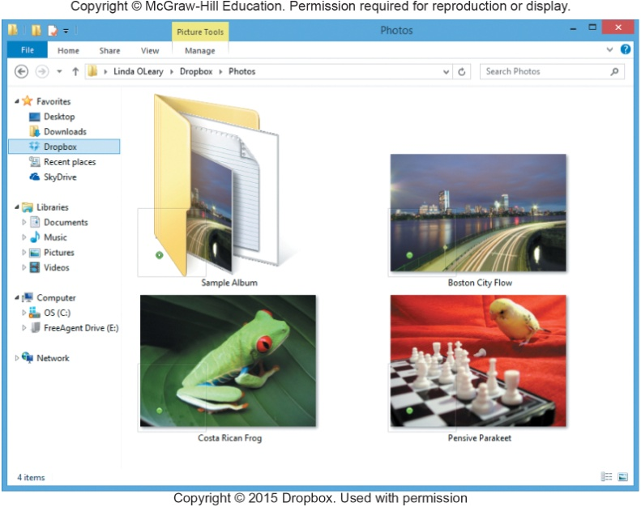
Making IT Work for You ~ Cloud Storage
Using a cloud storage service makes it easy to upload and share files with anyone.
Starting Dropbox Dropbox Sharing Dropbox
Step 1 Step 2

Slide 18
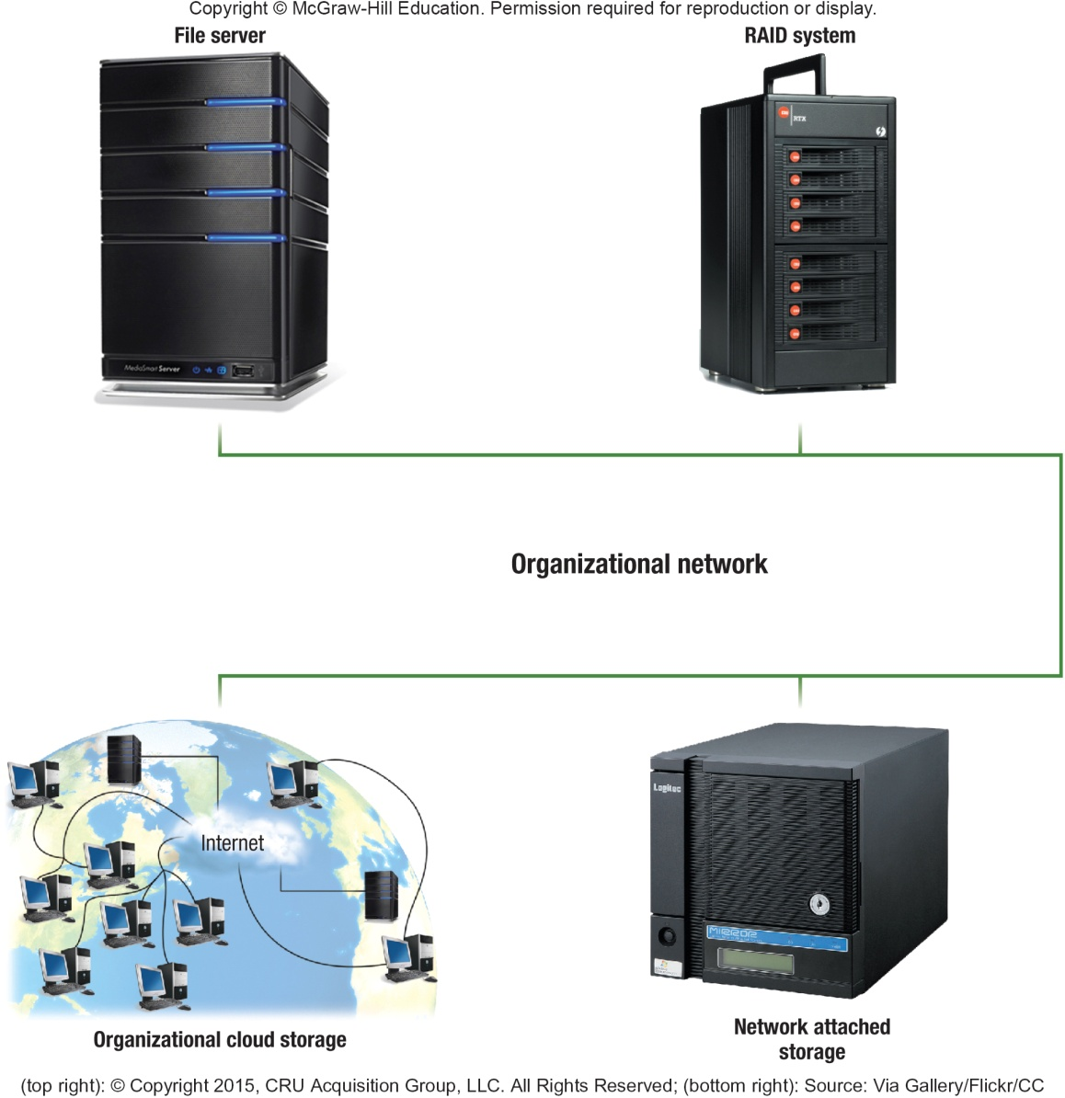
Mass Storage Devices
To meet the needs of organizations requiring large amounts of secondary storage requirements
Enterprise storage system
Safe use of data across an organizational network
Devices include:
File servers
Networked attached storage (NAS)
RAID systems
Organizational cloud storage
Notes:
Mass storage devices (key term) are designed to meet the demands for a tremendous amount of mass storage (key term).

Slide 19
Storage Area Network (SAN)
Architecture to link remote computer storage devices
Enterprise storage systems can be connected to
Computers to provide local system access
User’s computer provides file system, but SAN provides disk space
House data in remote locations and still allow efficient and secure access
Notes:
Storage area network (SAN) (key term) – a recent mass storage development.

Slide 20

Careers In IT
Disaster recovery specialists are responsible for recovering systems and data after a disaster strokes
General employer requirements
Bachelors or associates degree in computer science or information systems
Experience in the field and skills in networking, security and DBA
Communication and skills and be able to handle high-sress situations
Annual salary of $70 K to $88 K

Slide 21
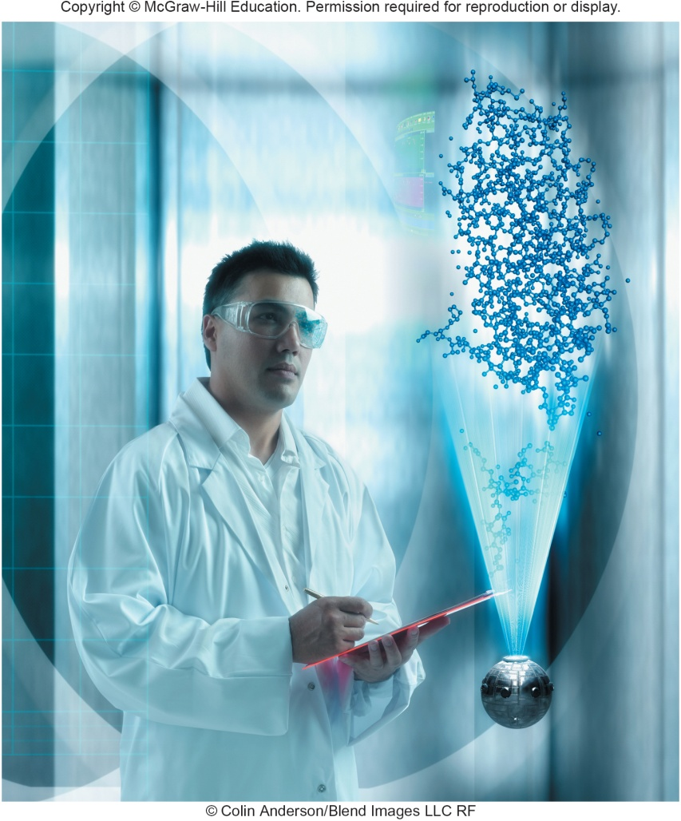
A Look to the Future ~ Next Generation Storage
At some point, hard drives will no longer be able to keep up
Looking at ways of increasing capacity without increasing size
Currently hard drive maxes out at 128 GB per square inch.
New technologies may advance this to 6.25 TG (6,250 GB) per square inch.
Notes:
Are you using the Cloud yet to store files?

Slide 22
Open-Ended Questions (Page 1 of 2)
Compare primary storage and secondary storage, and discuss the most important characteristics of secondary storage.
Discuss hard disks including density, platters, tracks, sectors, cylinders, head crashes, internal, external, and performance enhancements.
Discuss solid-state storage including solid-state drives, flash memory, and USB drives.
Notes:
Have students turn to the end of Chapter 7 in their textbooks to view the same “Open-Ended” questions/statements

Slide 23
Open-Ended Questions (Page 2 of 2)
Discuss optical disks including pits, lands, CDs, DVDs, Blu-ray, and hi def.
Discuss cloud computing and cloud storage.
Describe mass storage devices including enterprise storage systems, file servers, network attached storage, RAID systems, organizational cloud storage, and storage area network systems.
Notes:
Have students turn to the end of Chapter 7 in their textbooks to view the same “Open-Ended” questions/statements

